Slide 1
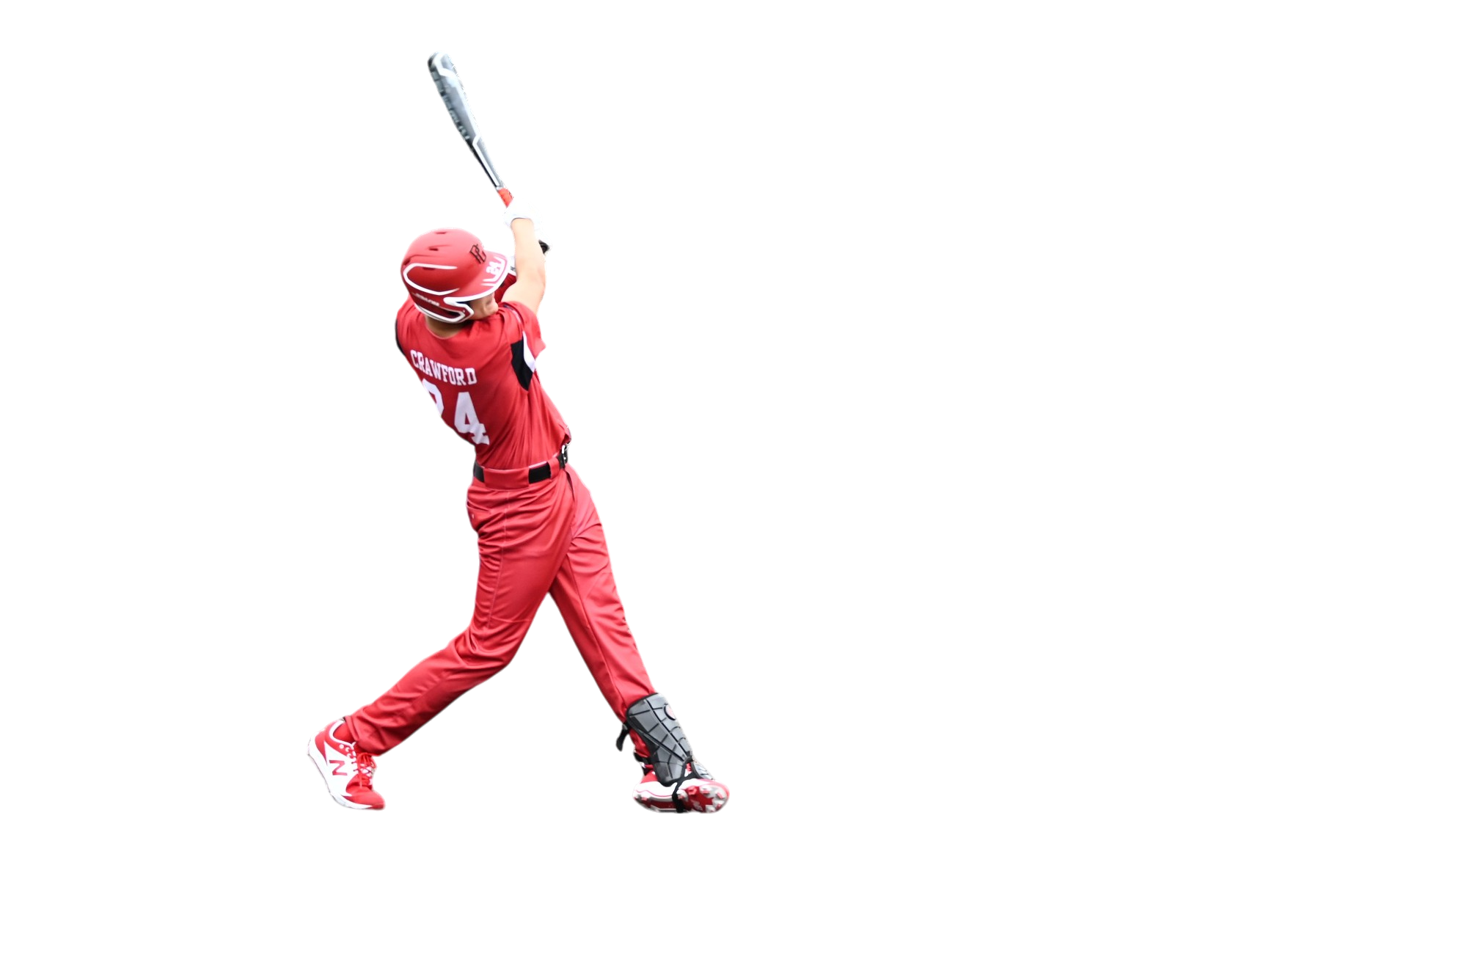

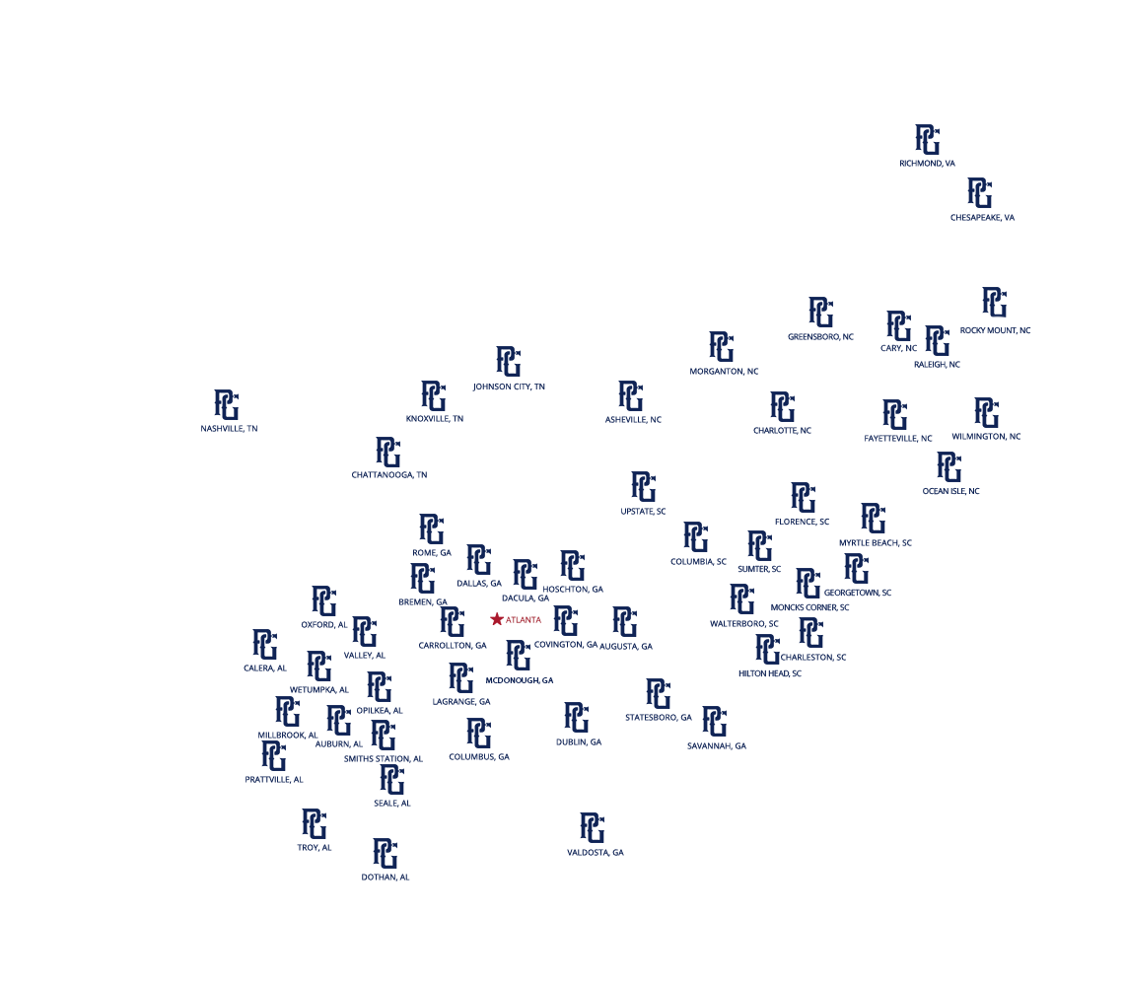
ORGANIZATION STRUCTURE AND FOOTPRINT
The partnership spans key territories, including North Carolina, South Carolina and sections of Alabama, Georgia, Tennessee and Virginia. Teams from all levels – AA (D3), AAA (D2), Majors (D1) and showcase programs – will now participate under the Perfect Game umbrella.

Slide 2

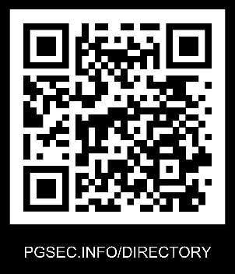
ORGANIZATIONAL CHART
Perfect Game SEC LLC oversees youth baseball and softball events and operations in the Southeast U.S. In essence, Perfect Game SEC LLC is a regional arm and partner dedicated to the mission of Perfect Game Inc.
PERFECT GAME SEC
ALABAMA, GEORGIA, NORTH CAROLINA, SOUTH CAROLINA, TENNESSE & VIRGINIA
DOMINICK FERRARO
PERFECT GAME SEC, LLC
CHRIS WELLS
PERFECT GAME SEC, LLC
PERFECT GAME SEC, LLC
ANDY KING
PERFECT GAME SEC, LLC
JASON GROSS
PG MIDLANDS, LLC
JOHN HAYES
PG SOUTHEAST SPORTS, LLC
MARY WILLIAMS
PG SEC SOFTBALL, LLC
BRETT MINICK
PG SAVANNAH, LLC
JEFF CASTELL
PG CSS, LLC
Last Updated: June 30, 2025
Notes:
Easily change photo. Please click on the small icon in the center of the holder and choose an image on your computer.

Slide 3

PERFECT GAME SEC
ORGANIZATION HEADS:
CHRIS WELLS, ANDY KING & DOMINICK FERRARO
PERFECT GAME SEC BASEBALL - ORGANIZATIONAL CHART
NORTH CAROLINA
CHARLOTTE
NORTH CAROLINA
TRIAD
NORTH CAROLINA
TRIANGLE
NORTH CAROLINA
WESTERN
SOUTH CAROLINA
UPSTATE
TENNESSE
STATEWIDE
VIRGINIA
SOUTHERN
JASON TERRY
REGIONAL DIRECTOR (Y)
BUBBA SMITH
REGIONAL DIRECTOR (Y)
TREY THOMPSON
REGIONAL DIRECTOR (Y)
CHAD MICHAELS
REGIONAL DIRECTOR (Y)
HOLDEN SMITH
REGIONAL DIRECTOR (Y)
THOMAS BRITTLE
REGIONAL DIRECTOR (Y/HS)
KENDAL STONE
REGIONAL DIRECTOR (Y)
KEVIN STOCKWELL
DIRECTOR TRIANGLE (Y)
TODD MILLER
DIRECTOR UPSTATE (Y)
HUNTER IVES
REGIONAL DIRECTOR (Y/HS)
DEREK BROOKSHIRE
ASSIGNOR / UIC(Y/HS)
JAMES GRIFFIN
UMPIRE IN CHARGE (Y)
MIKE ANDERSON
DIRECTOR DOWNEAST (Y)
JOHNNY HUMPRIES
ASSIGNOR / UIC (Y)
CHRIS GOODRICH
REGIONAL DIRECTOR (Y/HS)
LOUIE NEWBERRY
ASSIGNOR / UIC (Y/HS)
RANDY SMITH
DIRECTOR OXFORD (Y)
JEFF HALL
REGIONAL DIRECTOR (HS)
SETH KEENER
ASSIGNOR/UIC (HS)
COREY WELCH
REGIONAL DIRECTOR (HS)
HUNTER IVES
ASSIGNOR / UIC (HS)
SCOTT JOHNSON
DIRECTOR (Y)
ROBERT “SHIRTY” SMITH
ASSIGNOR / UIC (Y)
NICOLE SANDERS
MANGER (MERCHANDISE)
Notes:
Easily change photo. Please click on the small icon in the center of the holder and choose an image on your computer.

Slide 4
PERFECT GAME SEC
ORGANIZATION HEADS:
JASON GROSS, JOHN HAYES, BRETT MINICK & JEFF CASTEEL
PERFECT GAME SEC BASEBALL - ORGANIZATIONAL CHART
CONTINUED
JOHN HAYES
MANAGING PARTNER
BRETT YOUNGBLOOD
ADMINISTRATOR
JASON GROSS
MANAGING PARTNER
JEFF/KAREN CASTEEL
MANAGING PARTNER
BRENT/LACEY CASTEEL
MANAGING PARTNER
BRETT MINICK
MANAGING PARTNER
NORTH CAROLINA
WILLMINGTON / FAYETTEVILE
SOUTH CAROLINA
COASTAL
SOUTH CAROLINA
MIDLANDS
GEORGIA
ATL METRO / SURROUNDING
ALABMA
STATEWIDE (AA/AAA)
GEORGIA
SAVANNAH
SAMUEL GUY
REGIONAL DIRECTOR (Y)
JAKE WILLARD
REGIONAL DIRECTOR (Y)
GEORGIA
AUGUSTA
JODY JOHNSON
DIRECTOR (Y)
DONNIE DARBY
DIRECTOR (Y)
GEORGIA
DUBLIN
ANGIE VAN DYNE
DIRECTOR (Y)
WALTER DUNSTON
UMPIRE IN CHARGE
JOSEPH BRAYBOY
UMPIRE IN CHARGE
LESLIE HOWELL
DIRECTOR (Y)
BUBBA SMITH
DUBLIN DIRECTOR (Y)
DERWIN ELLISON
ASSIGNOR
SAM LEBRON
ASSIGNOR (Y)
TAE LOVELACE
ASSIGNOR
BRENT HANEY
ASSIGNOR
RHETT BARBER
DIRECTOR (Y)
CARSON MASON
DIRECTOR (Y)
CHAD MCGINTY
UMPIRE IN CHARGE (Y)
DEREK GOODMAN
ASSIGNOR
WES BROOKS
UMPIRE IN CHARGE
MIKE WLECH
ASSIGNOR / UIC (Y)
Notes:
Easily change photo. Please click on the small icon in the center of the holder and choose an image on your computer.

Slide 5
PERFECT GAME SEC
ORGANIZATION HEADS:
Mary WILLIAMS, CHRIS WELLS, ANDY KING & DOMINICK FERRARO
PERFECT GAME SEC SOFTBALL - ORGANIZATIONAL CHART
NORTH CAROLINA
CHARLOTTE
NORTH CAROLINA
TRIAD / DOWNEAST
SOUTH CAROLINA
COAST
SOUTH CAROLINA
UPSTATE
SOUTH CAROLINA
BEACH / MIDLANDS
ELIZABETH CONNER (HQ4)
REGIONAL DIRECTOR (Y)
MARY WILLIAMS
MANAGING PARTNER
DANA STREETT
REGIONAL DIRECTOR (Y)
DUSTIN SIMPSON
REGIONAL DIRECTOR (Y)
CARRIE LYONS
REGIONAL DIRECTOR (Y)
AL DAHLGREN (HQ4)
REGIONAL DIRECTOR (Y)
JOHNNY HUMPRIES
ASSIGNOR / UIC (Y/HS)
LOUIS BILES
UMPIRE IN CHARGE (Y/HS)
Notes:
Easily change photo. Please click on the small icon in the center of the holder and choose an image on your computer.

